Slide 1


NovaBank
STRATEGIC DATA ANALYSIS
NovaPass Rewards Strategy
Defining the future of premium banking rewards in Latin America through data-driven insight.

Slide 2

NovaBank
Executive Summary
The Business Problem
NovaBank’s current flat 1.5x rewards model is uncompetitive and fails to optimize profit margins across diverse spending categories. Transitioning to a dynamic tiering system is essential to capture high-value market segments and protect the bank's profitability.
The Business Question
“What specific spending tiers and merchant categories will maximize customer engagement while maintaining sustainable revenue for the NovaPass card?”

Slide 3



NovaBank
Insights & Strategic Solution
Key Analytical Findings
The "NovaPass" Solution
83% of total revenue is tied to international travel spending.
Implement a 3-tier dynamic multiplier system focused on capturing the travel corridor while stabilizing margins on domestic swipes.
79% of revenue is driven by "High" and "Premium" spend brackets (>$100).
Travel categories (Flights/Hotels) represent the primary revenue pillar.
Total Revenue $1.16M
Total Transactions 9,646
Average Transaction $120.83

Slide 4

NovaBank
Methodology & Data Prep
The Dataset
Processed 9,646 anonymized transaction records from the NovaBank core database, specifically isolating Latin American resident behaviors.
Main Data Cleaning Steps
Step 1: Standardized "Clean Category" using SQL CASE logic to unify merchant naming conventions.
Analysis Assumptions
Step 2: Handled null values in "Age" by imputing median cohorts to maintain demographic integrity.
Mapped Residency: Transactions in cities outside residency country are treated as "International."
Step 3: Converted and normalized all local currencies to USD for unified revenue comparison.
Fixed Tiers: Merchant categories are grouped based on industry habit (e.g., Grocery as Daily Habit).

Slide 5
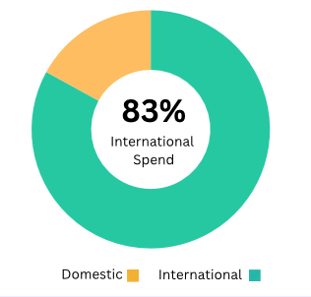
NovaBank
International Spend Dominates Portfolio
CHART ANALYSIS: TRANSACTION VOLUME BY LOCATION TYPE
The Steps To Conclusion
1. Segmentation: We compared the 'Country of Residence' vs. the 'Transaction City' to flag cross-border movement.
2. Aggregation: Visualizing the split revealed a de facto "Travel Identity" for NovaBank users.
3. Result: 83% of our users are already high-frequency international travelers, making a global rewards benefit the #1 acquisition lever.

Slide 6
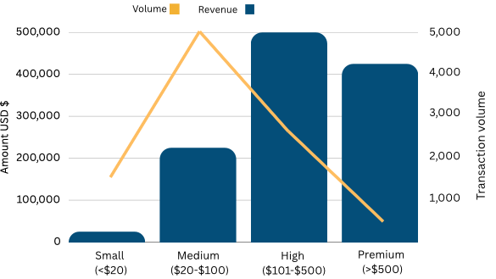
NovaBank
High-Value Purchases Drive Revenue
CHART ANALYSIS: REVENUE DISTRIBUTION VS. SWIPE VOLUME
The Steps: Binned transactions into spend tiers to find the most efficient spot
Result: While swipes are highest in 'Medium', revenue is concentrated in 'High' and 'Premium', justifying higher multipliers for $100+ spends.

Slide 7
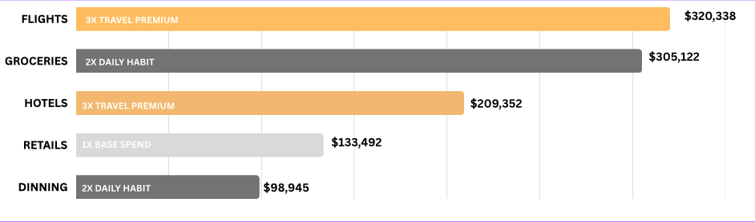
NovaBank
Tiered Roadmap for Strategic Yield
CHART ANALYSIS: TOTAL SPEND BY MERCHANT CATEGORY
Conclusion Path: Aggregated revenue by industry. We assigned ‘3x’ to the pillars that define travel identity, and ‘2x’ to habit-forming spend (Groceries) to stay “top of wallet”

Slide 8
NovaBank
Final Recommendation
Adopt a "Premium Travel" Identity: Pivot marketing toward the "Global Citizen" persona. 83% of revenue is international, so aligning branding with this actual behavior will drive higher acquisition.
Eliminate FX Fees: Remove foreign transaction fees to lock in our dominant 83% international share. This removes the primary friction point for high-value travelers, ensuring NovaPass remains "top-of-wallet" abroad.
Implement 3/2/1 Reward Tiers: Move to a tiered structure (3x Travel, 2x Daily Habits, 1x Base). This protects profit margins by capping rewards on small swipes while incentivizing the high-ticket spend that drives 79% of revenue.

